Slide 1

Project-one
What makes a popular song on Spotify?
Analyzed by Jon Wood and Meme Guerrini

Slide 2
Motivation
What makes a popular song on Spotify?

Slide 3
Questions & Data
What are the top 10 Genres by utilization using pie?
How do genres corelate with popularity?
What correlations can be identified for - Popularity vs. Danceability vs. Energy vs. Tempo vs. Valence vs. Duration vs. Loudness ?

Slide 4
Questions & Data
We choose to analyze Spotify’s top 200 weekly charting songs from 2020-01 to 2021-08, with a dataset that started with 1556 rows and 23 unique columns
We will Analyze each song based on various meta data to see if any correlations exist between popularity and key attributes such as Danceability, Energy, Valence, Tempo ..
Using a Spotify database downloaded from https://www.kaggle.com/sashankpillai/spotify-top-200-charts-20202021/version/2
We made some assumptions like if a song is more danceable or has a higher stream count it will probably be more popular.

Slide 5
Data Cleanup & Exploration
The data had some issues with regards to running analysis on it to make comparisons on the popularity field :
(some had 0 and we felt had no bearing on "what makes a song popular”
There were also a number of records with incomplete data and so we only wanted to use information from records that were complete.
Finally the genre info was stored in such a way that it was really difficult to try and utilize matplotlib chart plotting so we had to reshape the genre data and explode it out into separate records to then be able to chart it with matplotlib.

Slide 6
Data Cleanup & Exploration
What we will explore
What are the top 10 Genres by utilization (pie chart)
How do genres corelate with popularity?
What correlations can be identified for popularity vs. Key Attributes such as Danceability , Energy, Valence, Tempo, Duration, Loudness.
And can we infer what metric contributes the most to a songs popularity?

Slide 7
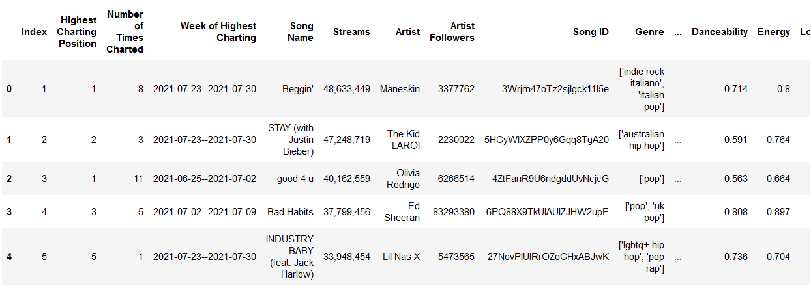
Data Analysis data frame

Slide 8
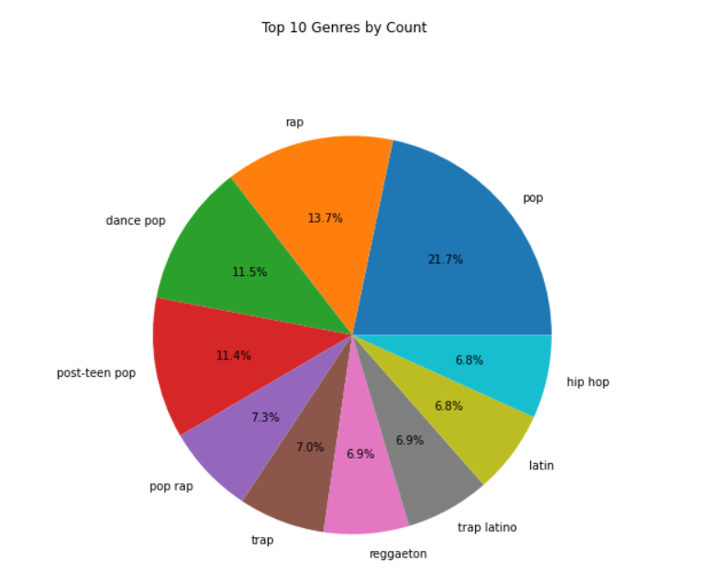
Data Analysis
Top 10 genres

Slide 9
Data Analysis
Top 10 genres

Slide 10
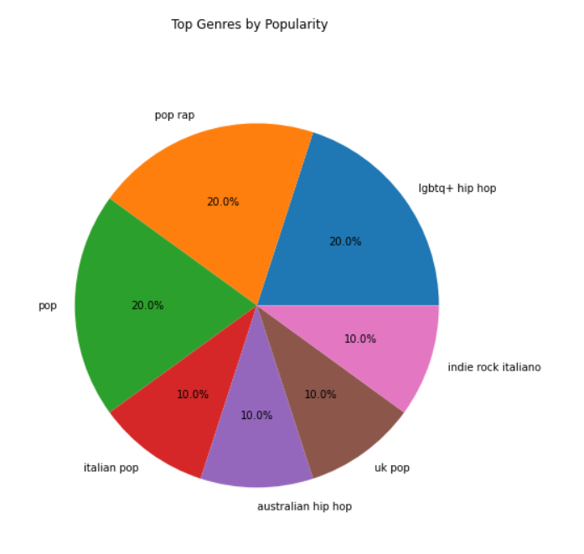
Data Analysis genres by count and genres by popularity

Slide 11
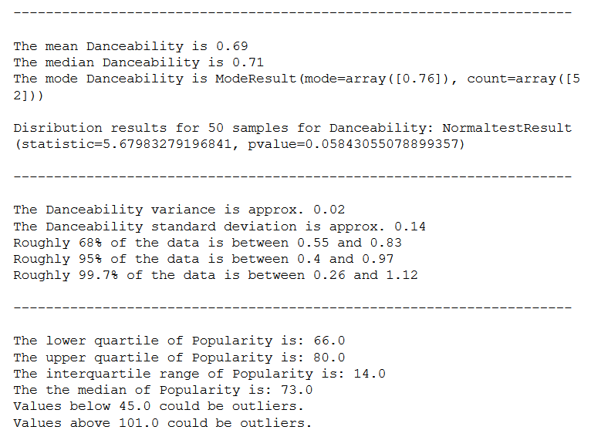
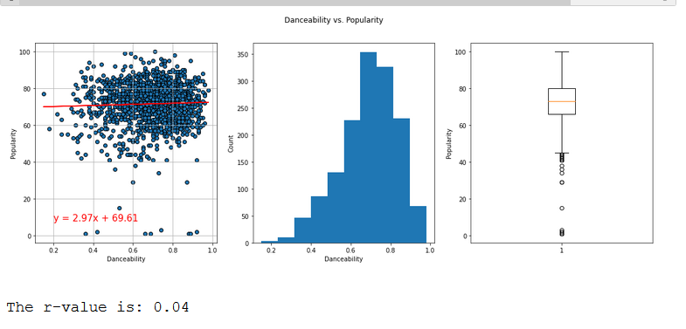
DATA Analysis danceability vs popularity

Slide 12
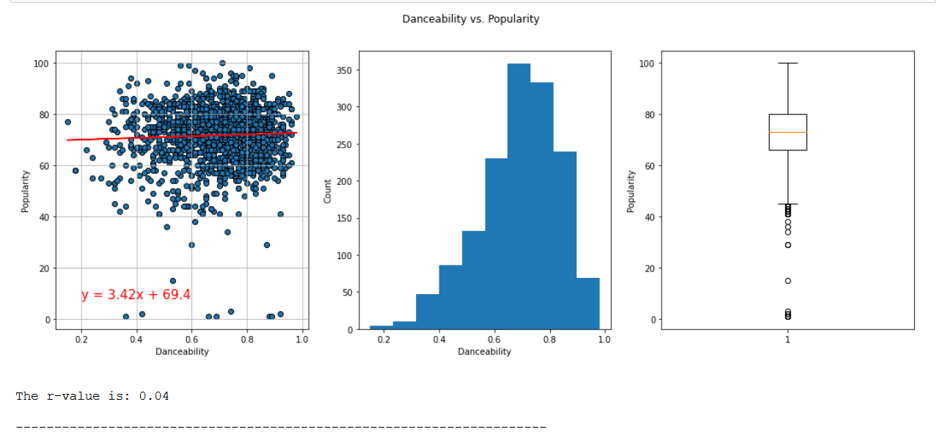
Data Analysis

Slide 13
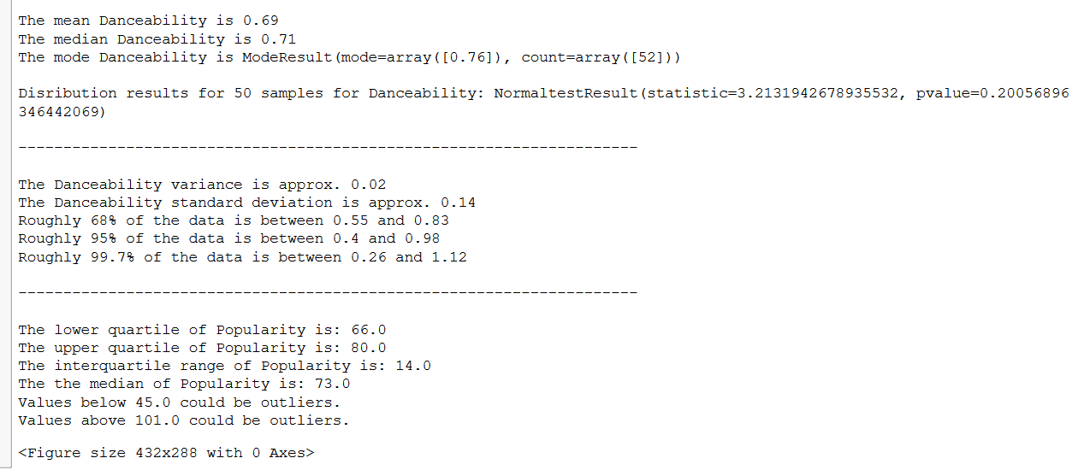
Data Analysis

Slide 14
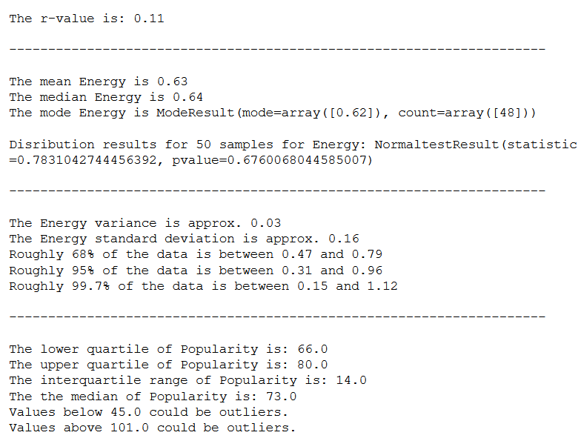
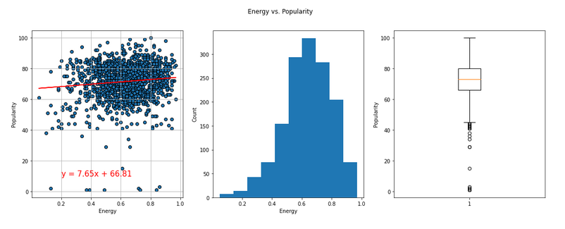
DATA Analysis energy vs popularity

Slide 15
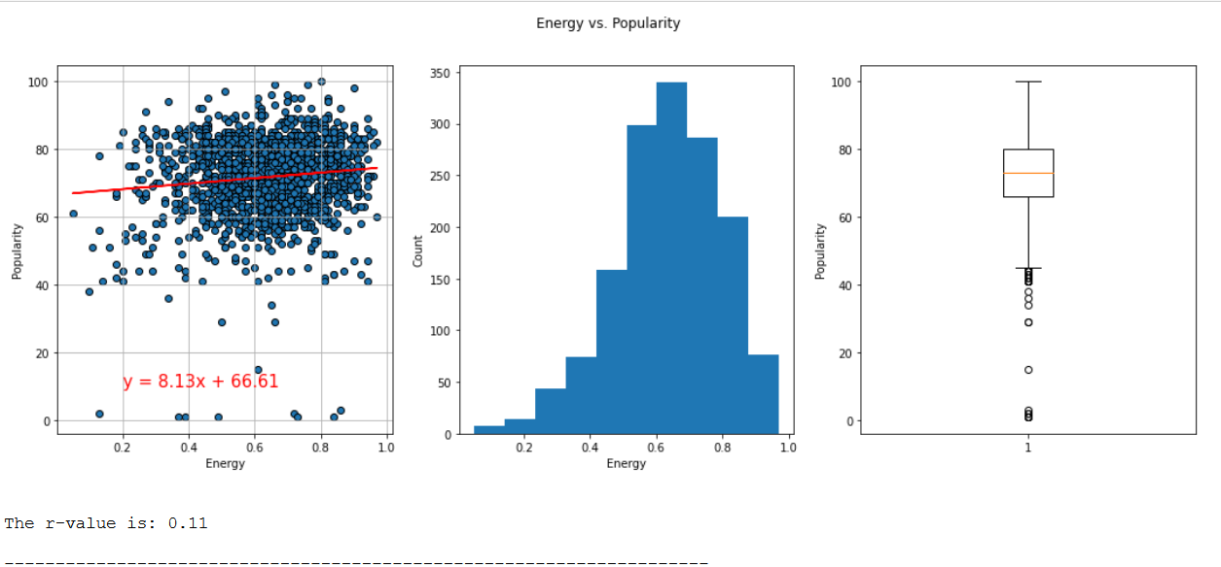

Slide 16
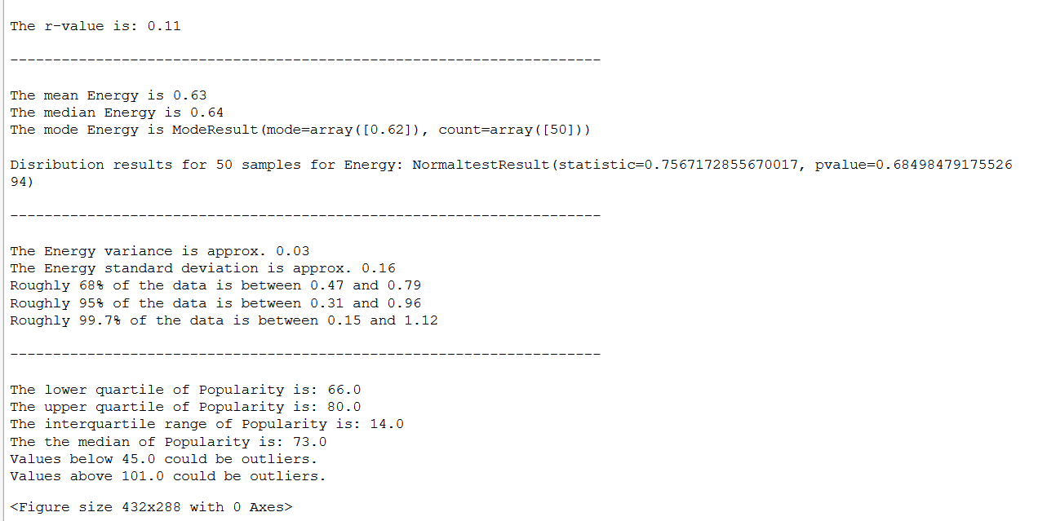

Slide 17
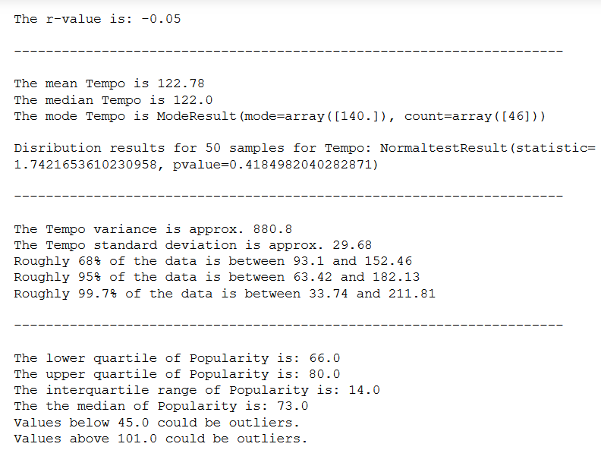
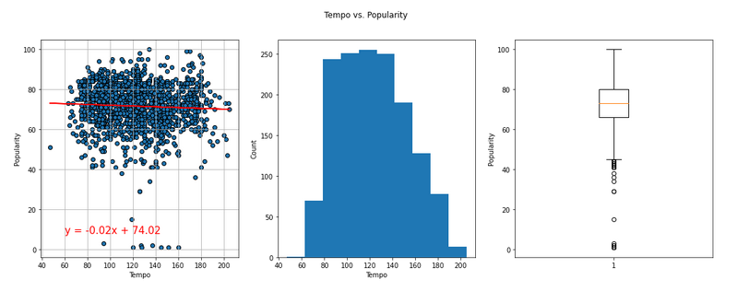
DATA Analysis tempo vs popularity

Slide 18
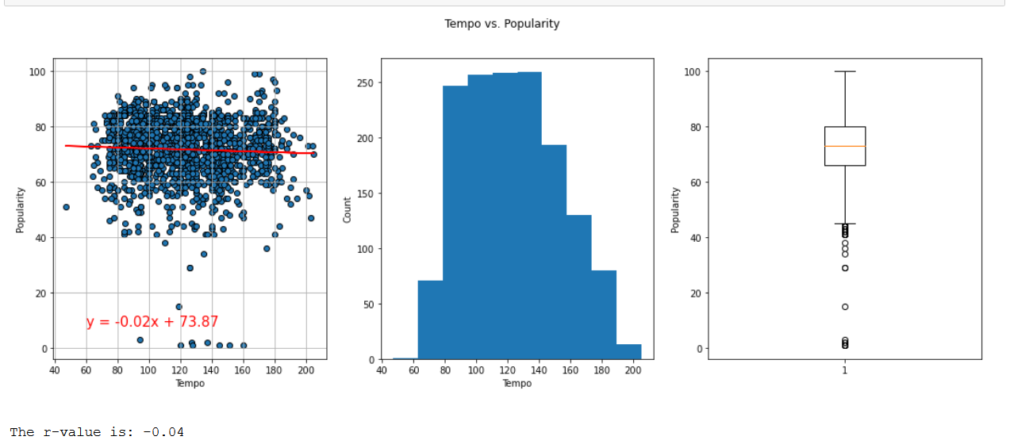

Slide 19
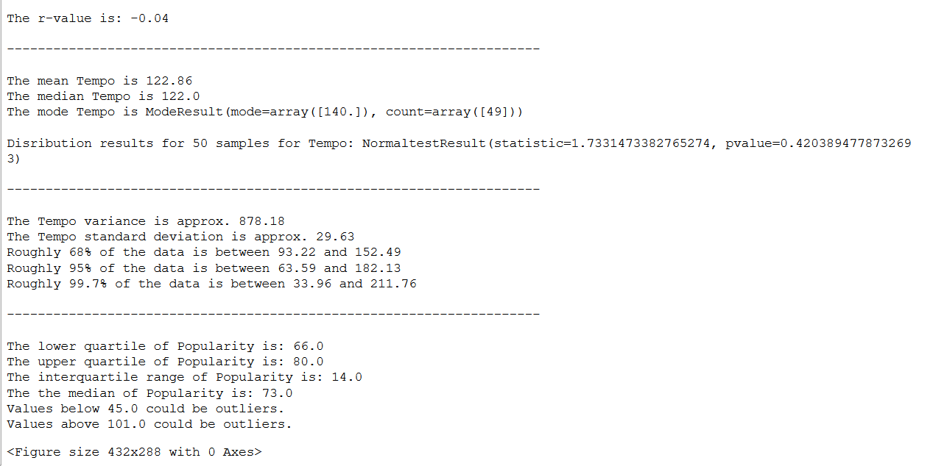

Slide 20
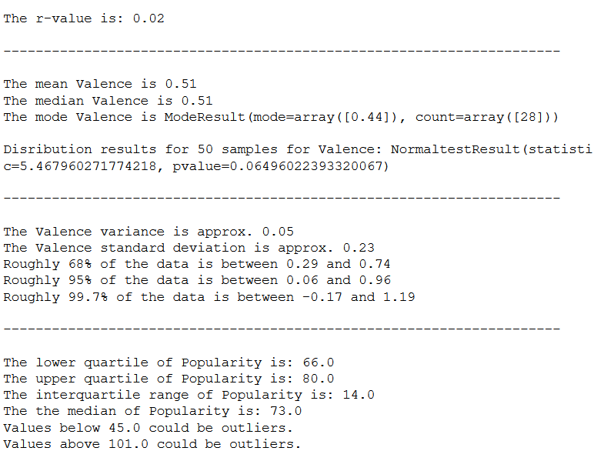
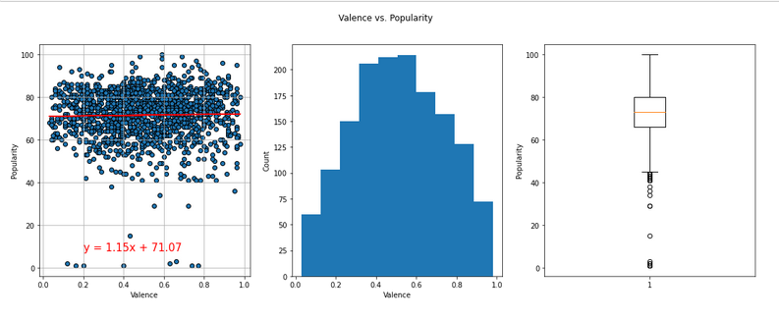
DATA Analysis valence vs popularity

Slide 21
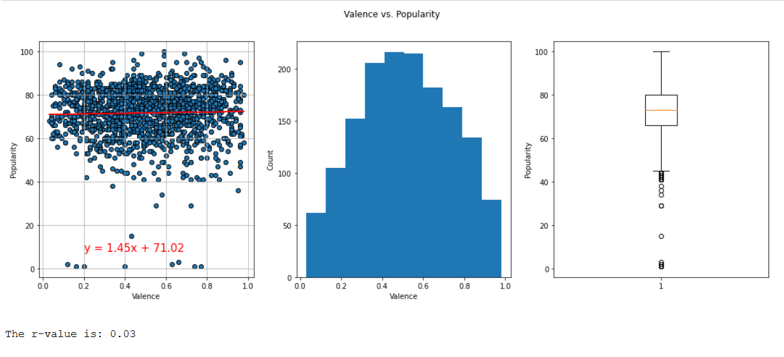

Slide 22
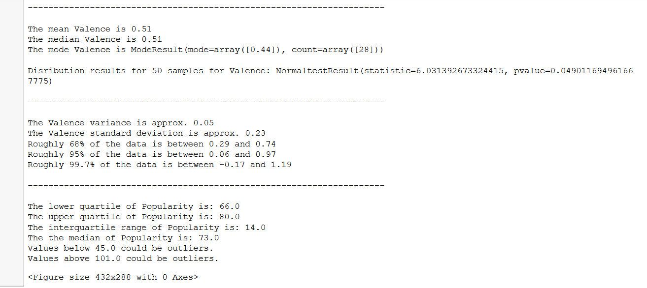

Slide 23
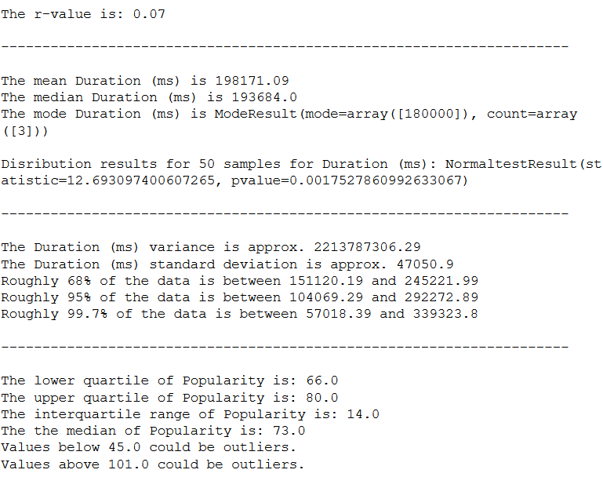
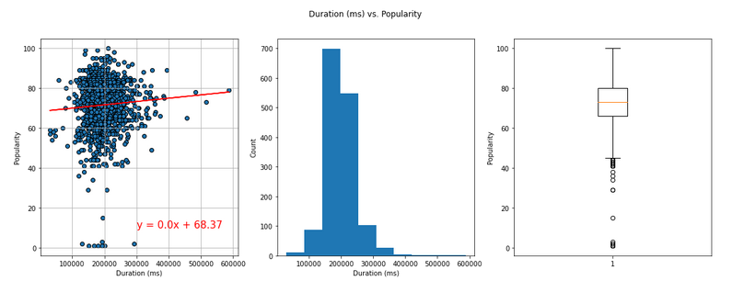
DATA Analysis duration (ms) vs popularity

Slide 24
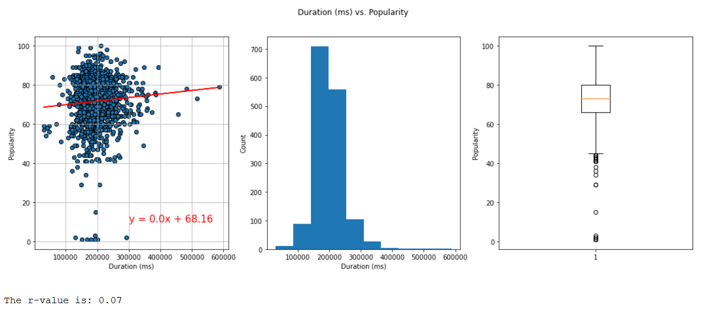

Slide 25
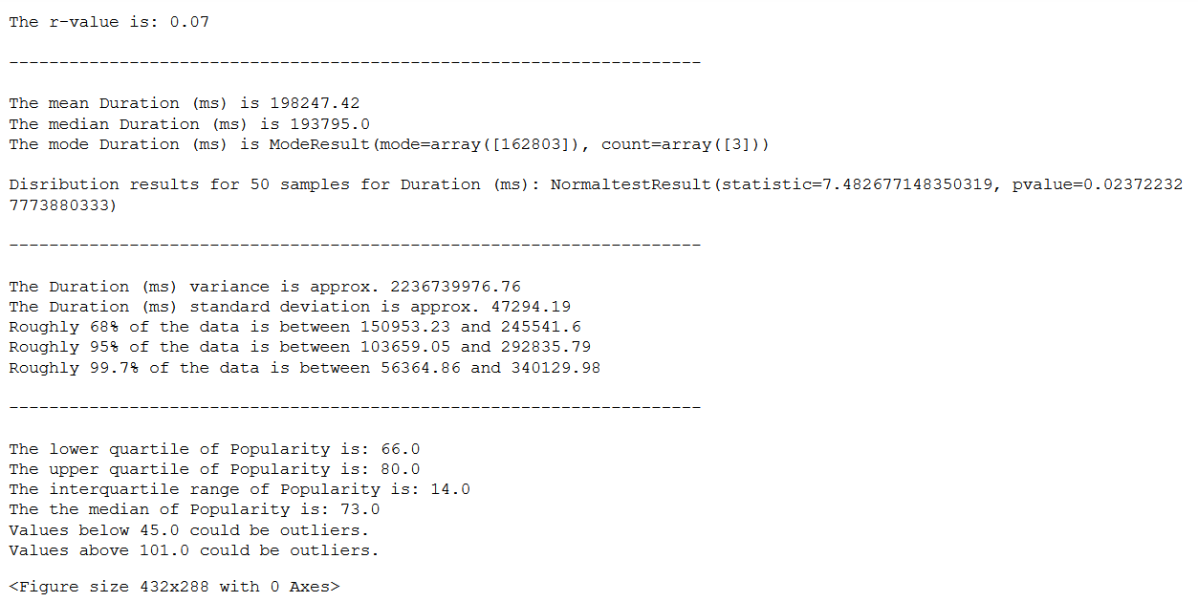

Slide 26
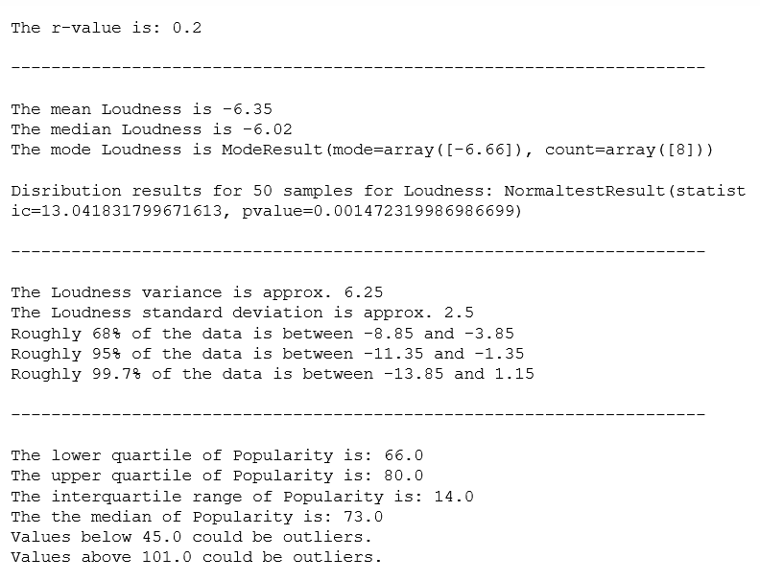
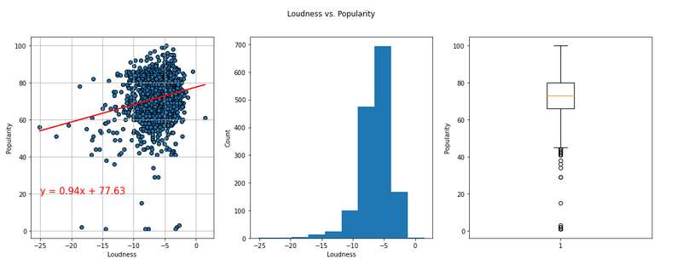
DATA Analysis Loudness vs popularity

Slide 27
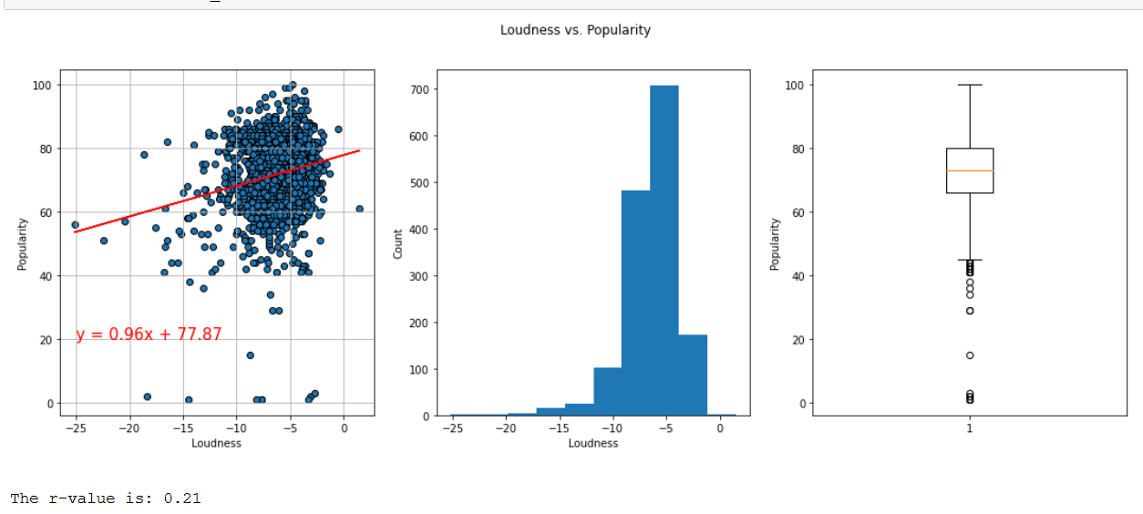

Slide 28
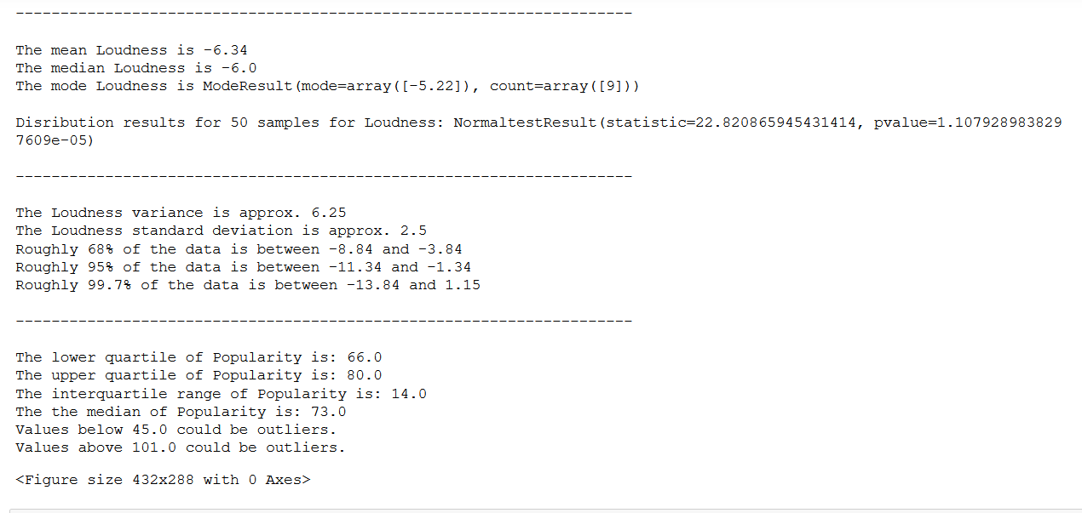

Slide 29
After refining our dataset we found the averages (and medians) for each key attribute.
IE – ACOUSTIC 0.180 // DANCEABILITY 0.697 // ENERGY 0.689 // TEMPO 116 ….
The data told us that “popular” songs had:
High danceability and energy
Low acousticness and speechiness
Tempo around 117 BPM

Slide 30
conclusion
In conclusion, we feel its safe to say that the more danceable, energetic, and “positive vibe inducing” a song is, the more popular it will probably be. The tempo and duration have to hit the sweet spot and the loudness needs to probably be consistent across the duration (we should plot that) to see a positive trend for popularity.

Slide 31
Post Mortem
The implications of your findings: what do your findings mean?
More analysis required to prove it out. Linear regression can allow for estimation and assumption, but something called an F-test can be done to better identify overall statistical significance.
Things we could look at further and explore with ML would be to be able to predict: Once an artist has a popular song, are more of that artists songs likely to become popular?

Slide 32
post
The implications of your findings: what do your findings mean?
More analysis required to prove it out. Linear regression can allow for estimation and assumption, but something called an F-test can be done to better identify overall statistical significance.

